Slide 1

Project UART Design
ECE-4146/5146 INTRODUCTION TO VHDL
By,
Dhanvin Athray – 801167002
Geraldine Shirley – 801104352

Slide 2
Outline
Introduction
Baud Rate Generator
FIFO Interface
UART Subsystem
Memory
Top module
Results

Slide 3
Introduction
Universal Asynchronous Receiver-Transmitter, is a computer hardware device that is used for asynchronous serial communication.
UART acts as an intermediary between parallel and serial interfaces.
Consists of a Transmitter and Receiver where :
on the Transmitter side , UART creates the data packet, appending sync and parity bits, and send that packet out the TX line with precise timing according to the set baud rate.
on the Receiver end, the UART samples the RX line at rates according to the expected baud rate, collect the sync bits, and displays the data.
BRAM is implemented where data from UART FIFO buffer Rx is sent to the RAM array on Mode 1 and data from RAM array is sent to FIFO buffer Tx on Mode 3.

Slide 4
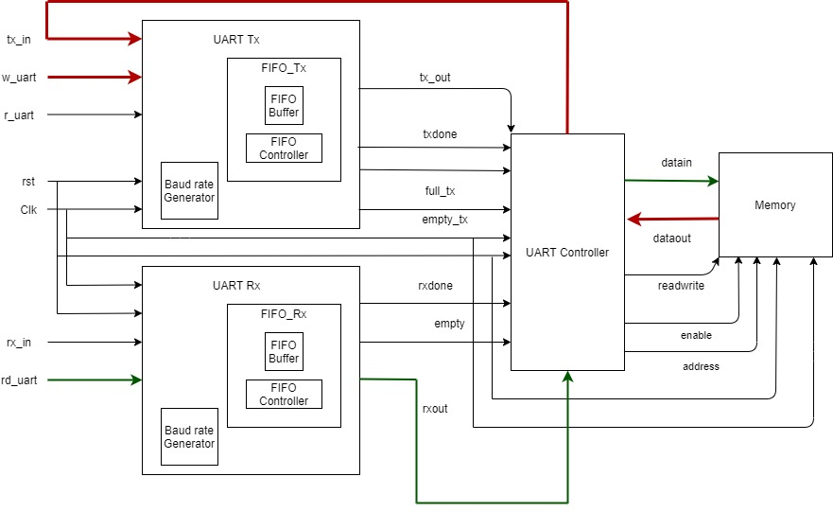
Overall System

Slide 5
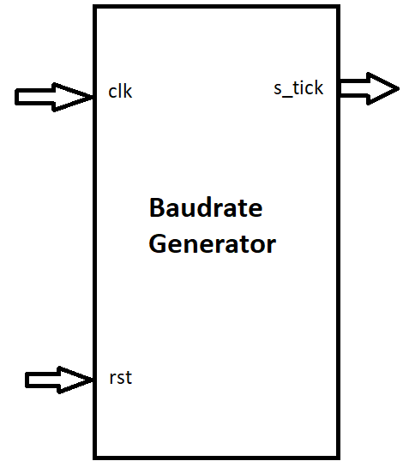
Baud Rate Generator
Baud rate generator is a clock generator which is used to determine the rate at which data is transmitted by a UART.
It takes a relatively high frequency and dividing it down to lower frequency.
Common baud rates are 2400, 4800, 9600 and 19,200.
A mod-163 counter is used to implement baud generator.
The tick output will assert for one clock cycle every 163 clock cycles of the system clock.

Slide 6
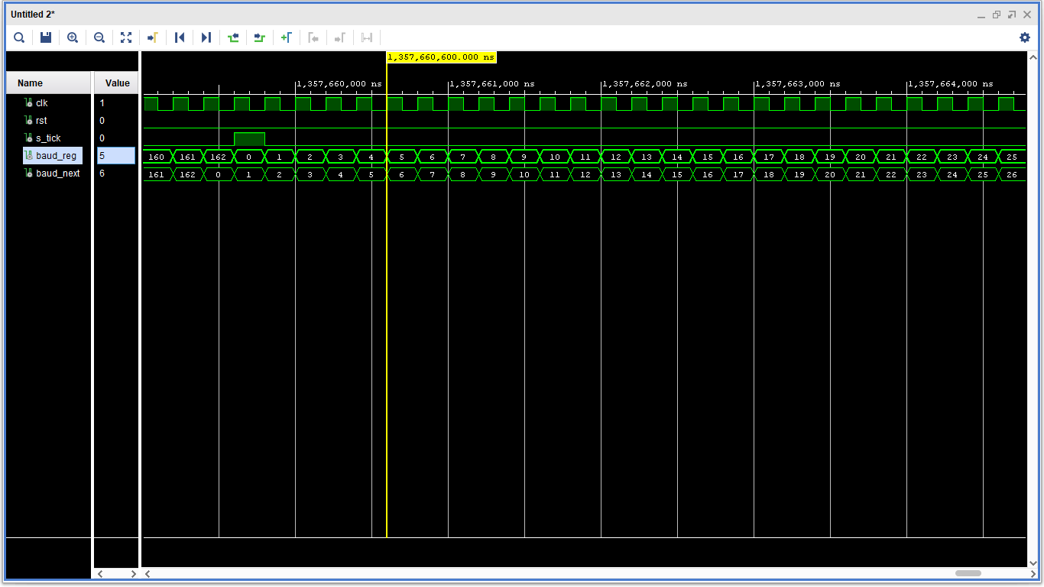
Waveform for Baud Rate Generator

Slide 7
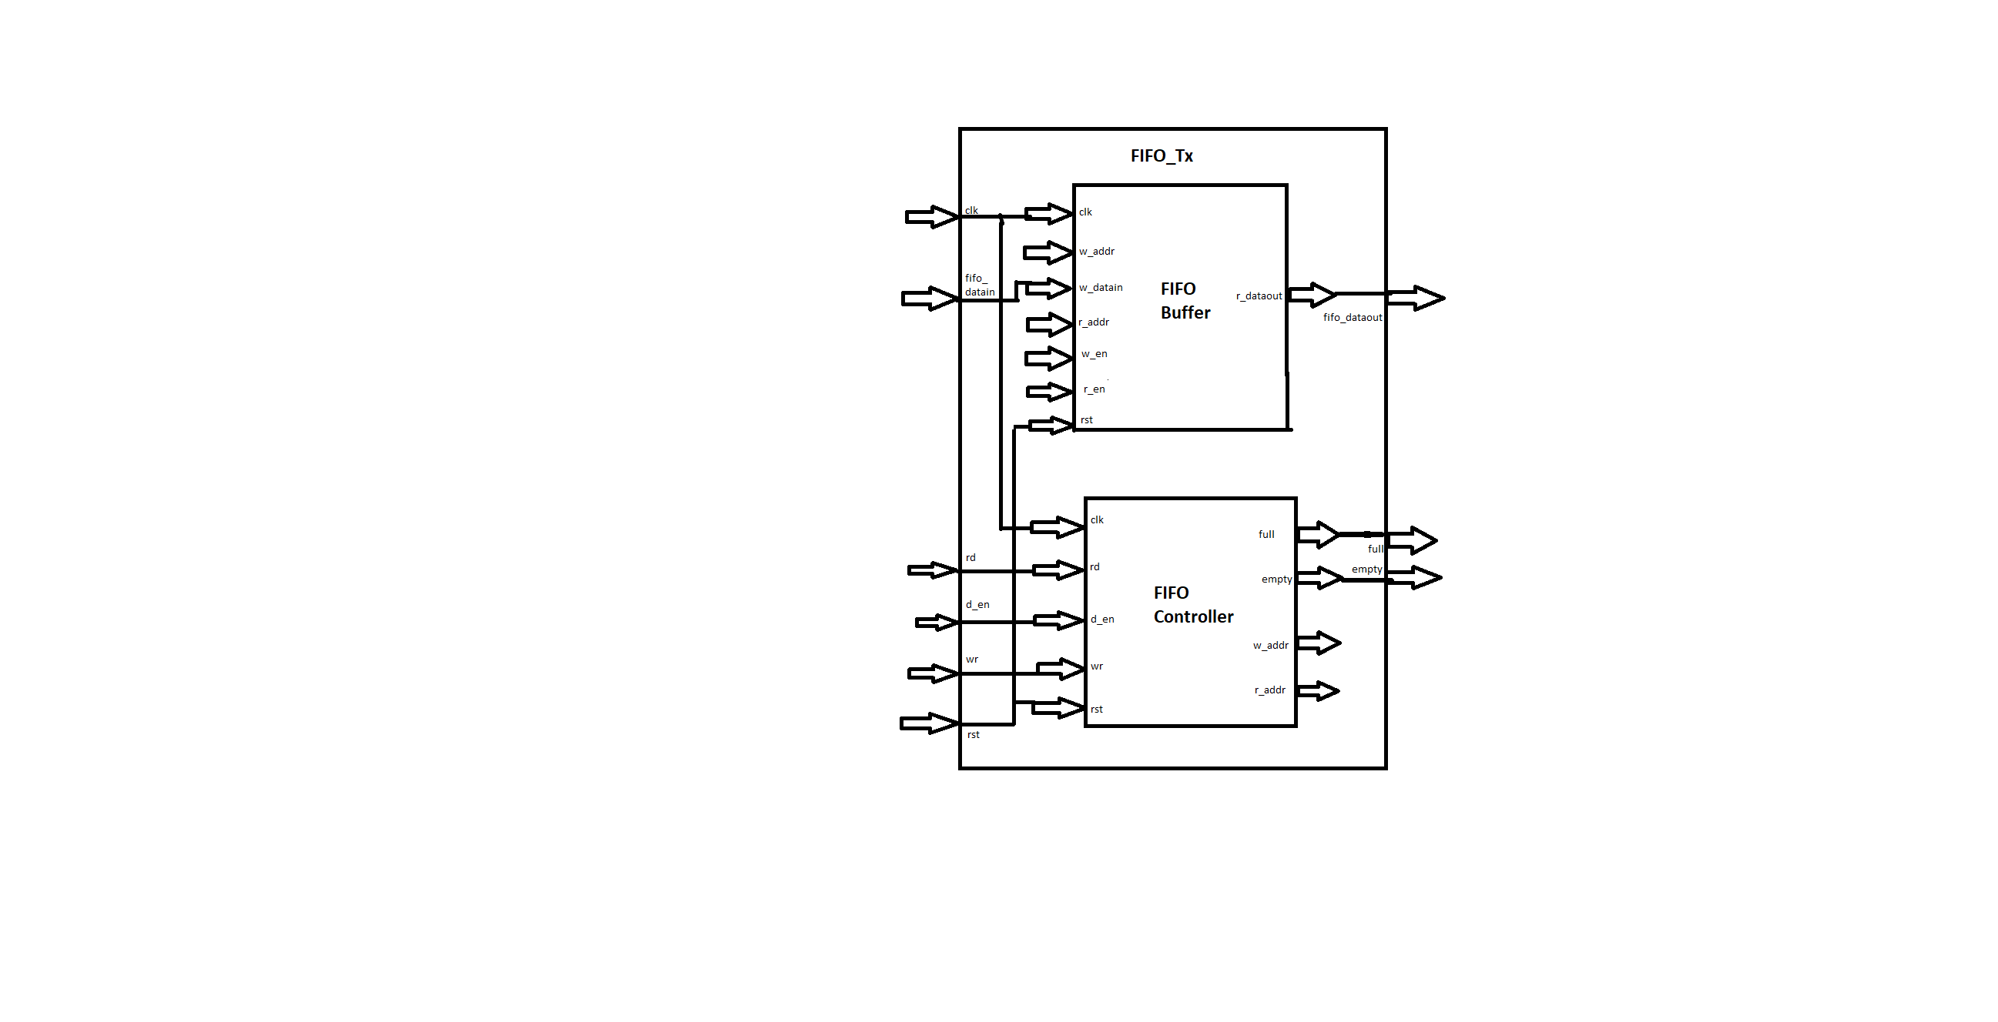
FIFO Interface Circuit
Transmitter:
FIFO buffer includes a control circuit to a generic memory array, such as register file.
FIFO buffer has a depth of 32 bytes.
During the write enable the data is written into the buffer and when the read enable is set the data is read form the buffer.
In the FIFO Controller the read and the write registers move to the next state when the empty and the full flags are zero, respectively.

Slide 8
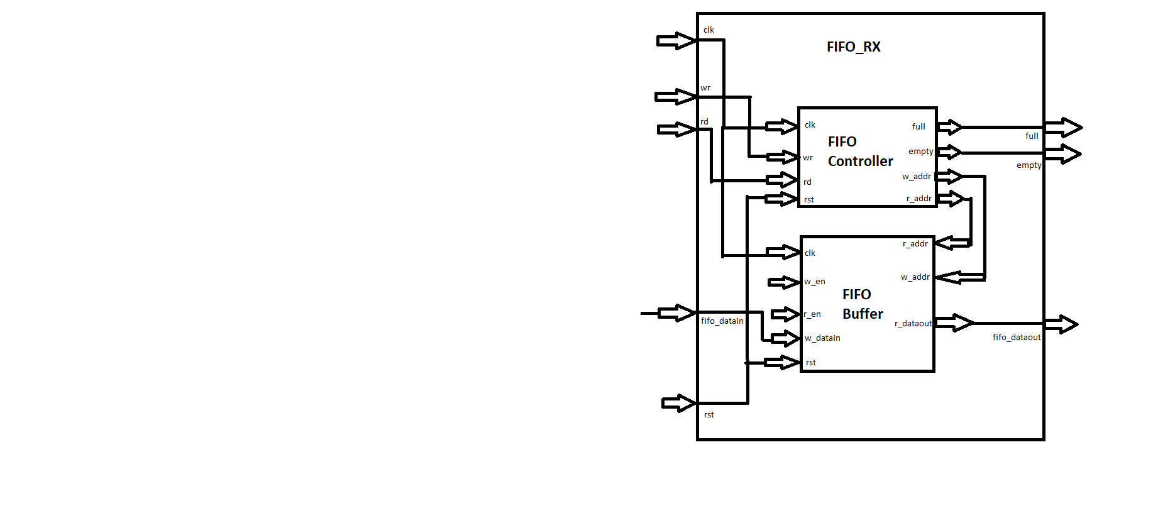
FIFO Interface Circuit
Receiver:
In empty buffer, no read operation is allowed.
After a few write operations, read operation can be performed.
After several write operations the buffer get full, and no write operation is allowed.
After several read operations, the buffer gets empty.

Slide 9
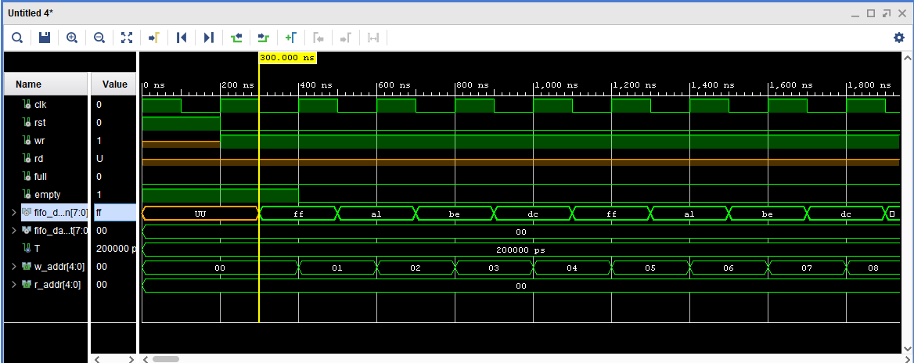
Waveform

Slide 10
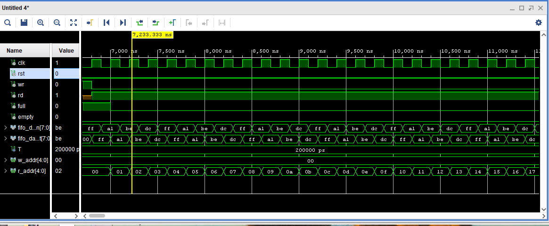
Waveform

Slide 11
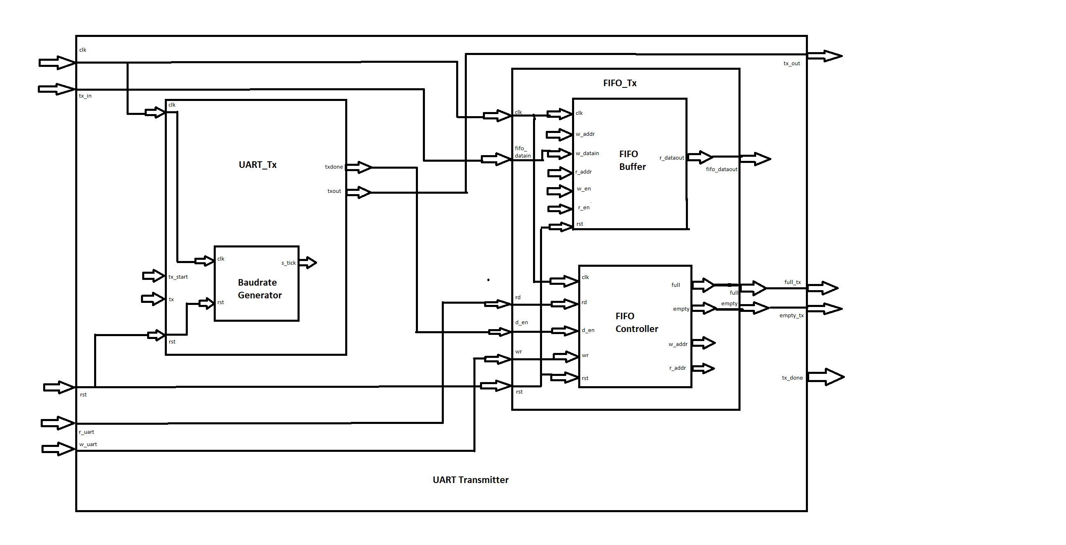
UART SUBSYSTEM: Transmitter

Slide 12
UART SUBSYSTEM
Transmitter:
Here the UART Tx is integrated with the FIFO Interface.
The Baud rate generator provides the signals to transmitter which will determine the next state.
A byte of data is loaded in parallel.
When w_uart= 1 the data is written in the buffer.
When r_uart =1
It checks for the empty and full flags.
When full=1 the data is read in tx_in and fifo_datain.
The Fifo buffer holds the data and when the full flag is asserted it stops reading the data.

Slide 13
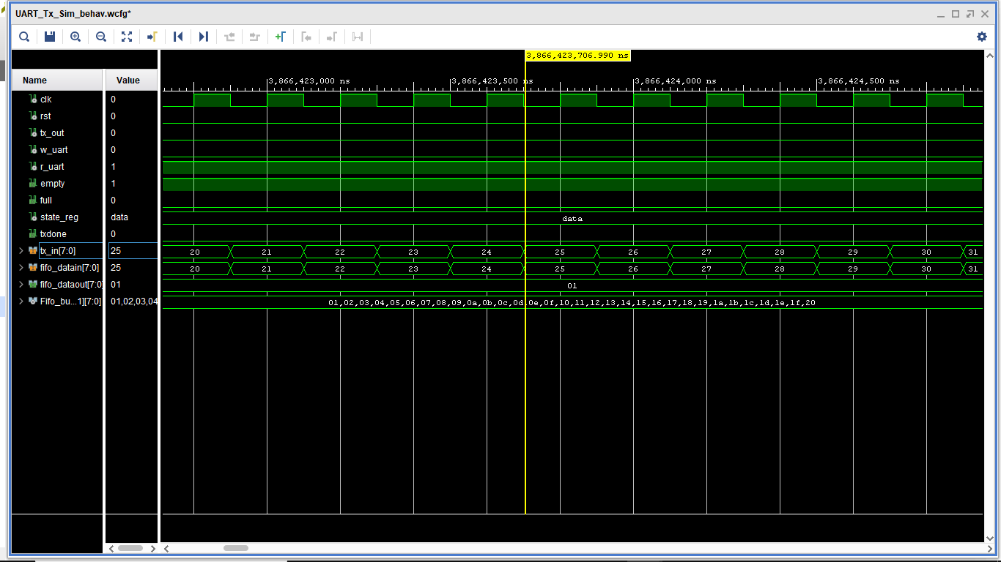
Waveform

Slide 14
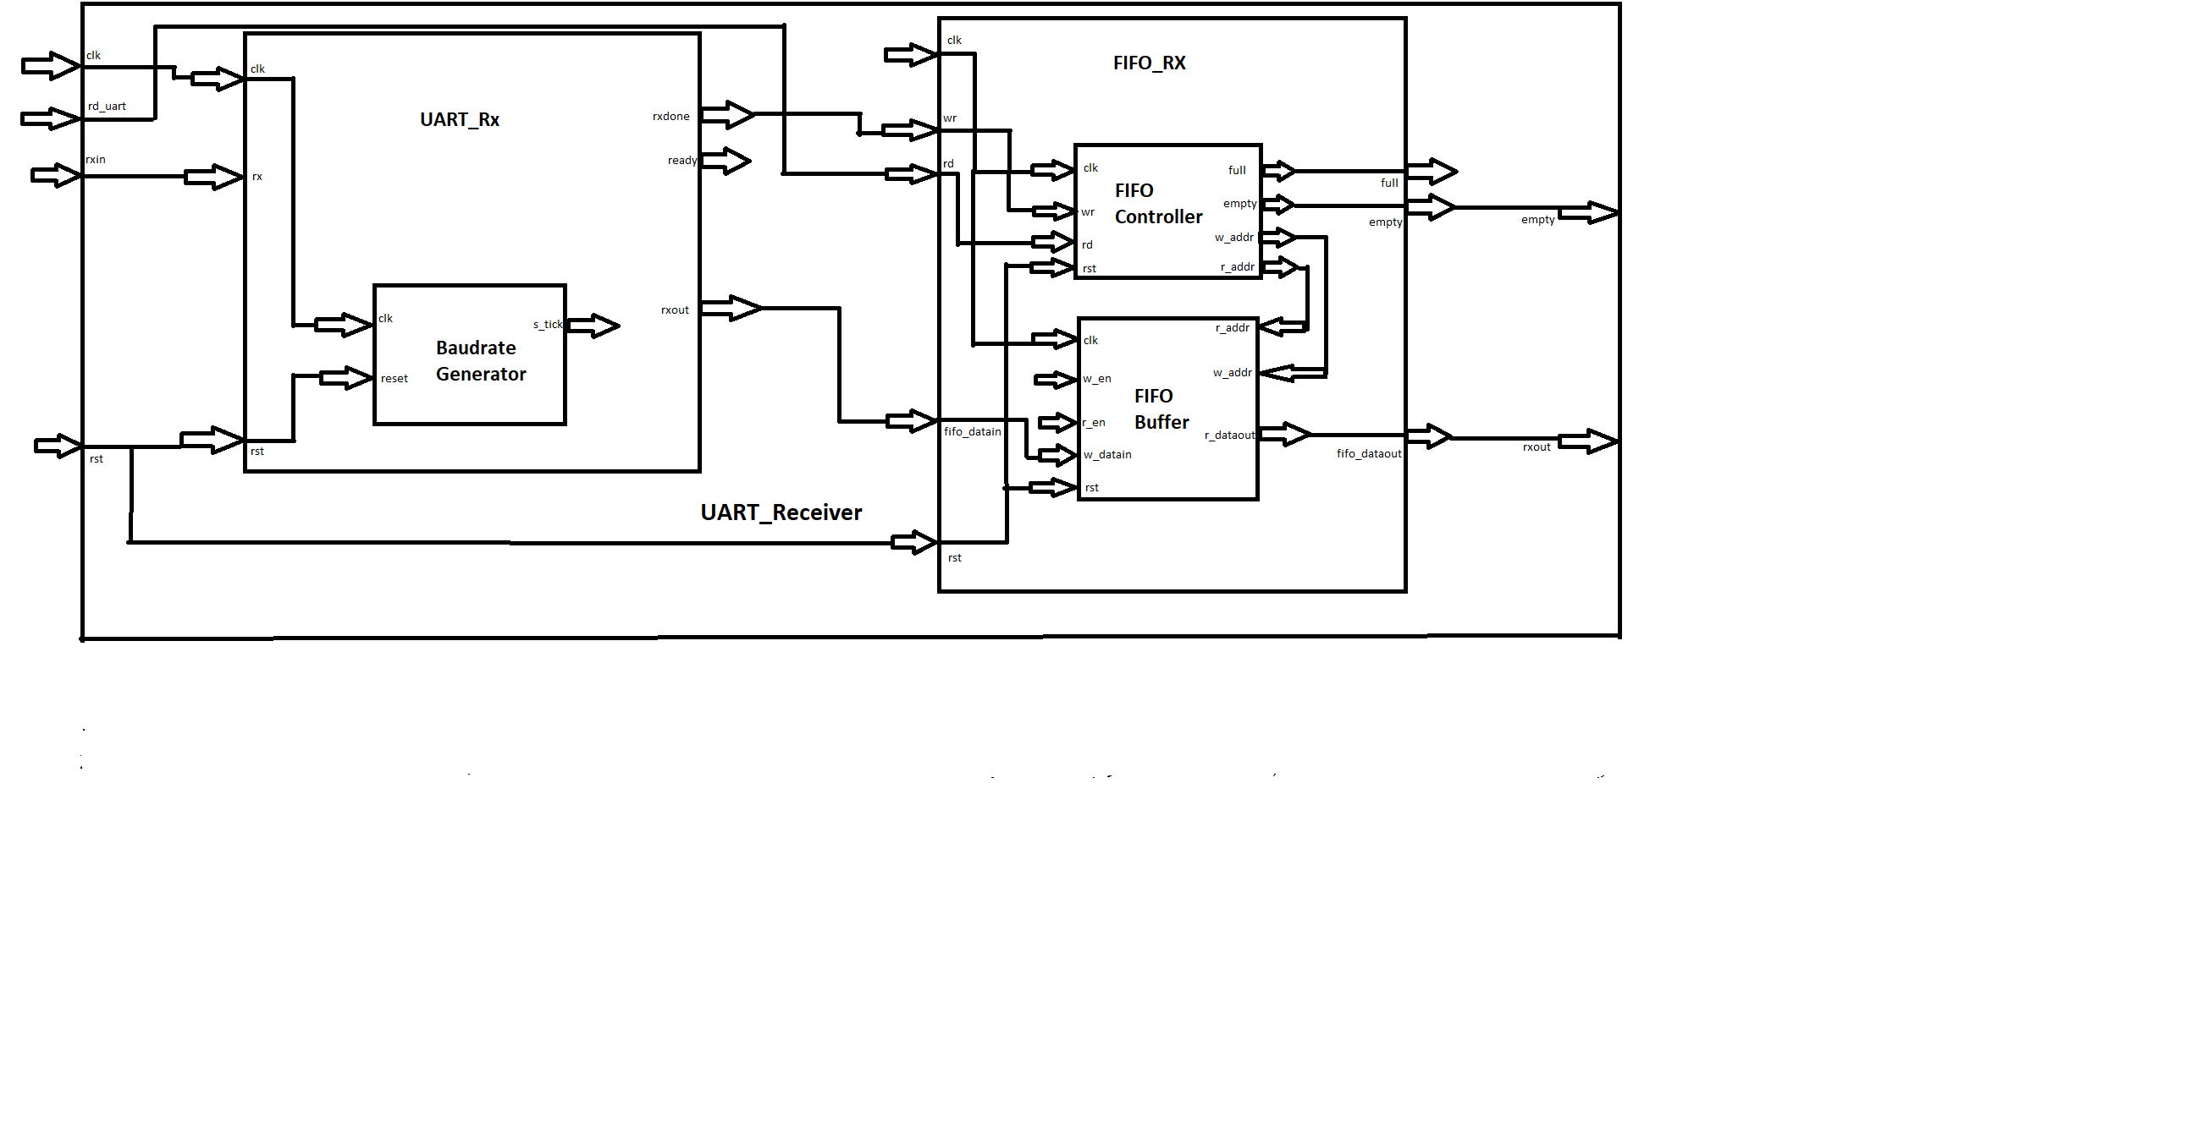
UART SUBSYSTEM: Receiver

Slide 15
UART SUBSYSTEM
Receiver
Here the UART Rx is integrated with the FIFO Interface.
The Baud rate generator provides the signals to receiver which will determine the next state.
When rd_uart =1:
It checks for the empty and full flags.
When empty=1 the data is available in rx_out and fifo_dataout.
The Fifo buffer holds the data and when the full flag is asserted it stops reading the data.

Slide 16
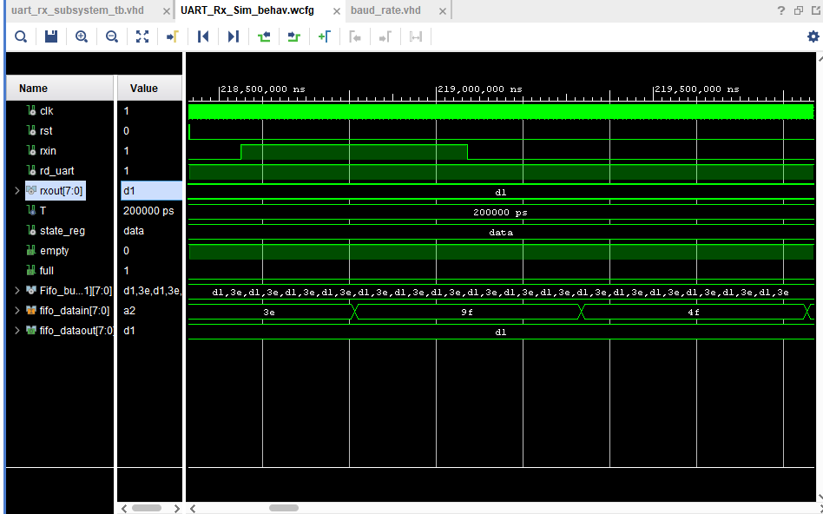
Waveform

Slide 17
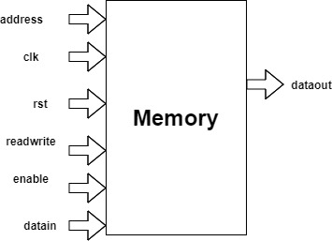
Memory
The BRAM is a dual-port RAM module instantiated into the FPGA fabric to provide on-chip storage for a relatively large set of data.
BRAM is used to transfer data between an FPGA target and a host processor by using a DMA FIFO.
In this project , BRAM is implemented , where data is written into the ram array from the UART Rx buffer and read from the ram array and written into the UART Tx buffer.

Slide 18
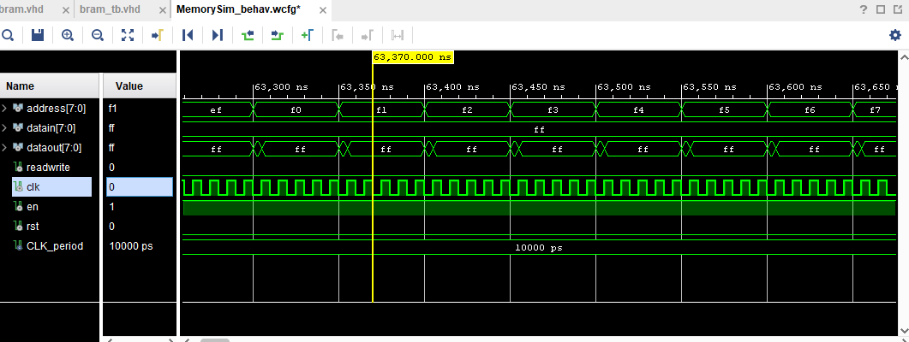
Waveform

Slide 19
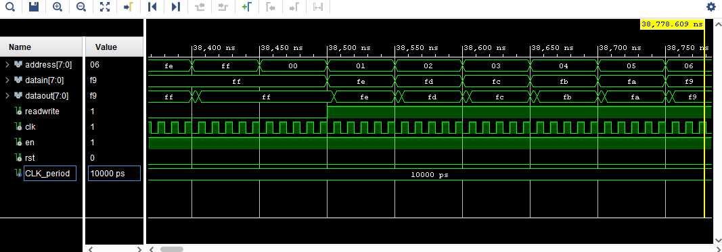
Waveform

Slide 20
UART Interface with Memory
Four different modes :
Mode 1:
When rd_uart_rx is set to 1, the data from FIFO buffer receiver is sent to the BRAM array.
Mode 2:
Reset all the flags in order to send the data from BRAM to UART.
Mode 3:
When wr_uart_tx is set to 1 , the data from BRAM array is sent to FIFO buffer Transmitter.
Mode 4:
Reset all the flags to carry out other operations.

Slide 21
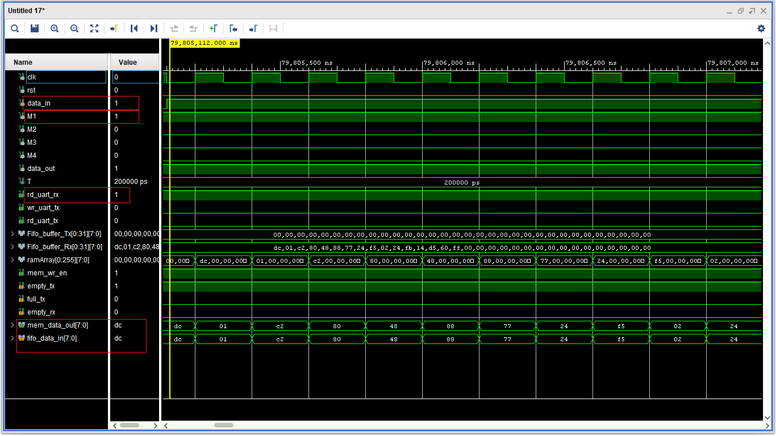
Mode 1:

Slide 22
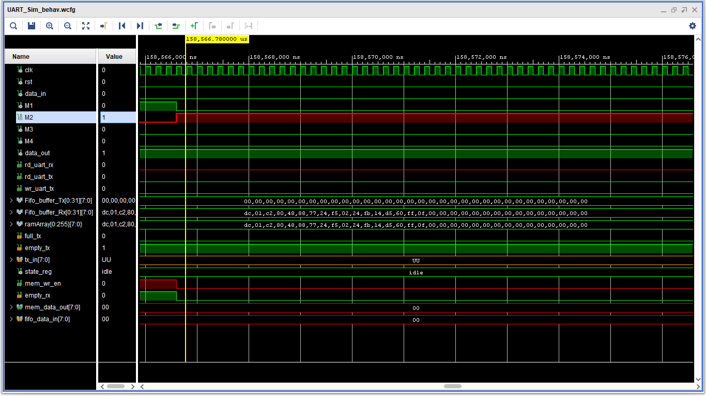
Mode 2:

Slide 23
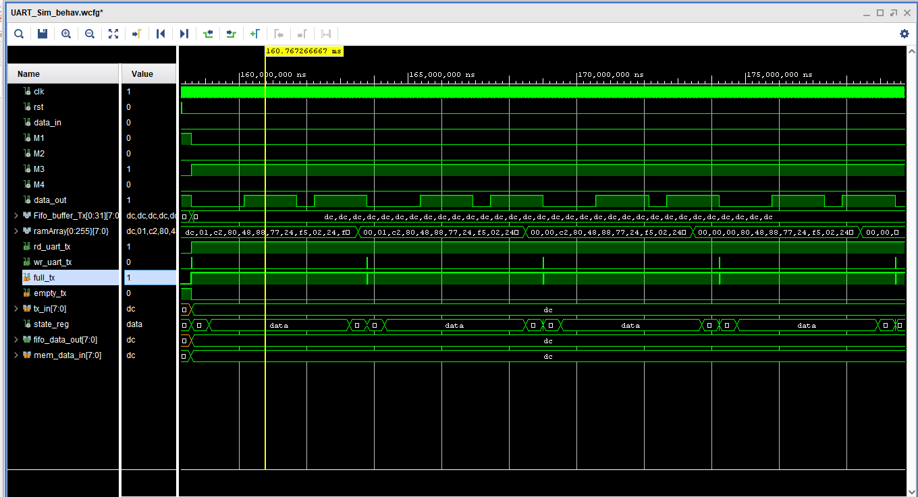
Mode 3:

Slide 24
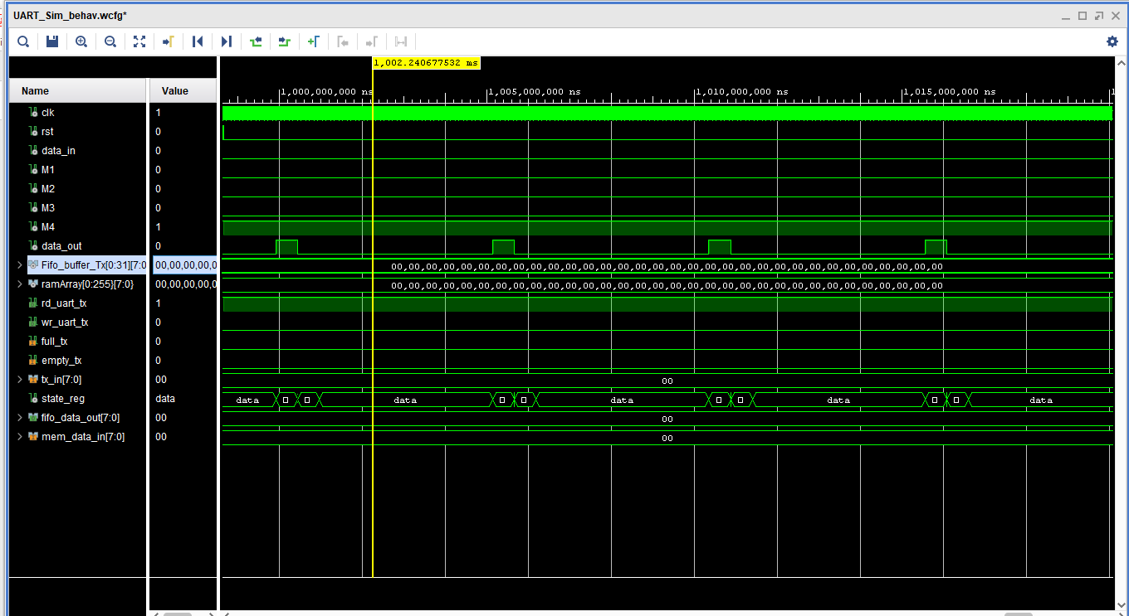
Mode 4:

Slide 25
THANK YOU!

